Slide 1
Rural Economic Development Grant Update

Slide 2
What is RED?
Ontario’s Rural Economic Development (RED) program provides cost-share funding to support activities that create strong rural communities in Ontario
Economic Diversification and Competitiveness Stream: This stream supports a range of projects to better position rural communities to attract and retain jobs, attract investment and enhance economic growth.
Sector/value chain development: Projects that implement strategies to strengthen and coordinate collaboration across sectors or value chains

Slide 3
RED and the OHA
The OHA was awarded a RED grant in 2024
Project start date: August 1, 2024
Project end date: June 30, 2026 (extended from February 28, 2026)
The total project cost is $44,030, with a cost share of 50%

Slide 4
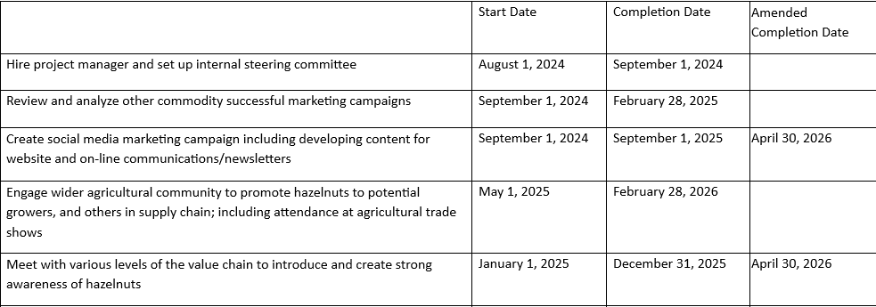
Work Plan

Slide 5
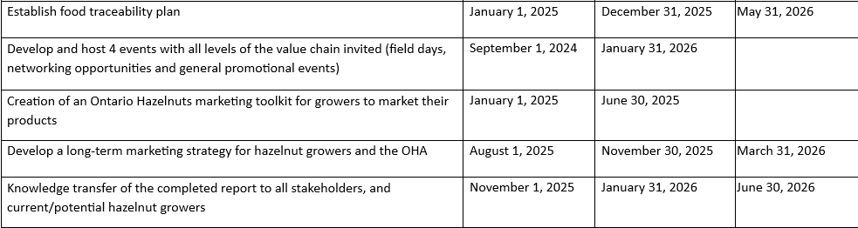
Work Plan

Slide 6
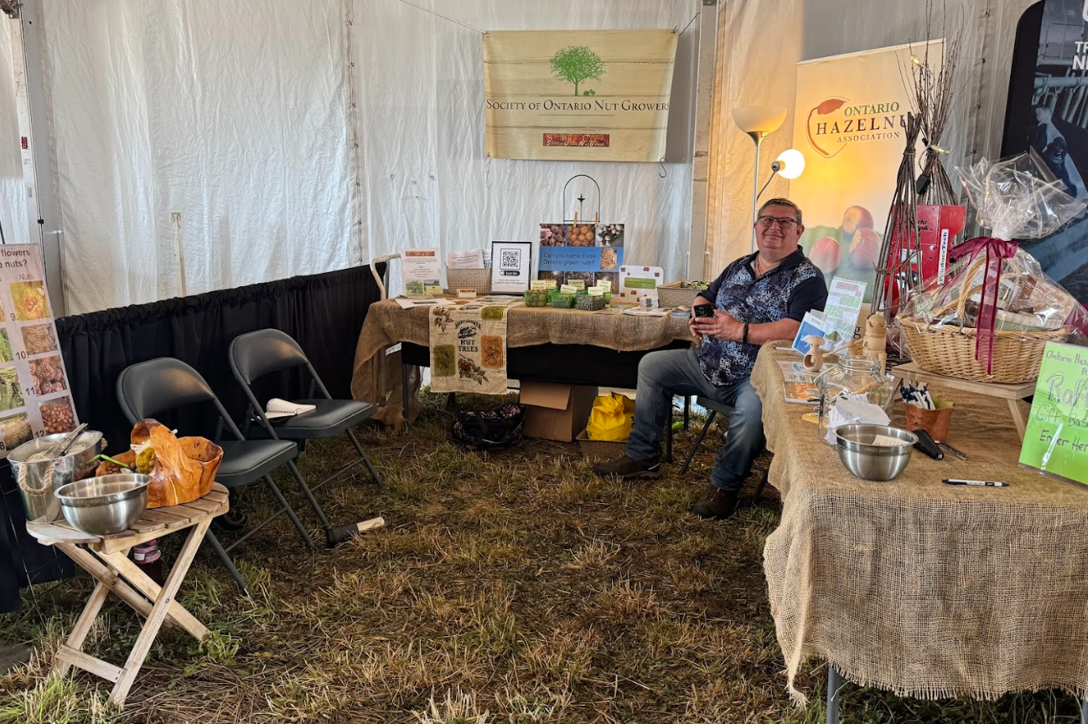
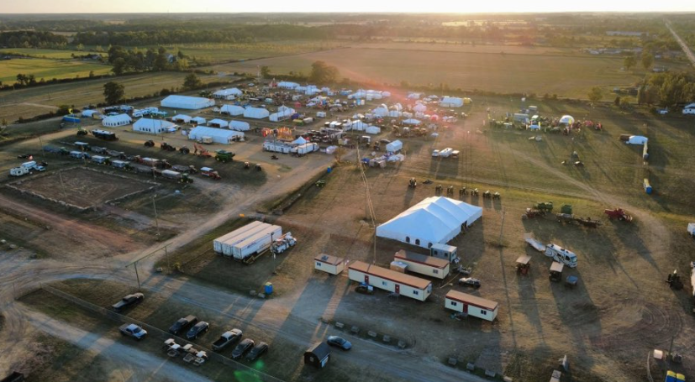
International Plowing Match
We had over 500 people enter our draw for a basket filled with hazelnut items!

Slide 7
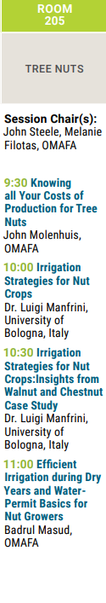
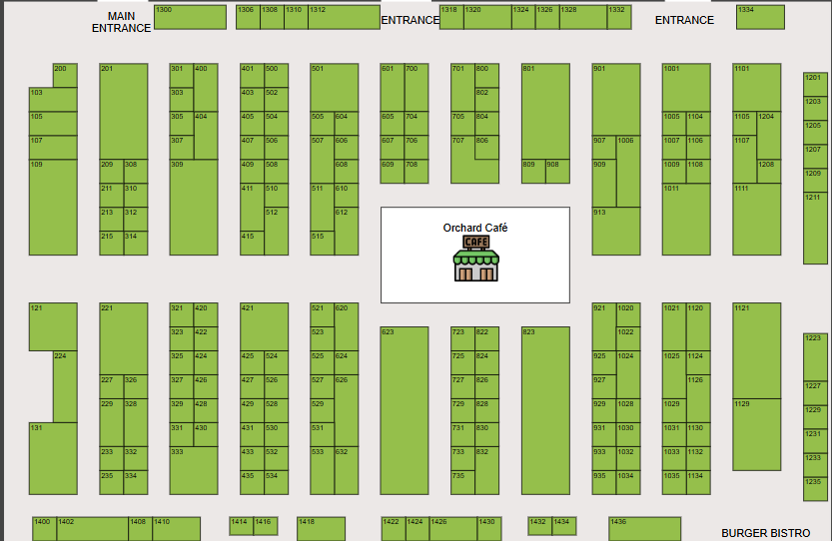

Ontario Fruit and Vegetable Convention

Slide 8
2026 Farm Tours
We are pleased to announce that we will be having 3 farm tours in summer 2026!
June 13 -- Nutcracker Ridge in Uxbridge
Late August -- Dalton White Farms in Delhi
October -- Nature’s Grow Inc in St. Catharines

Slide 9
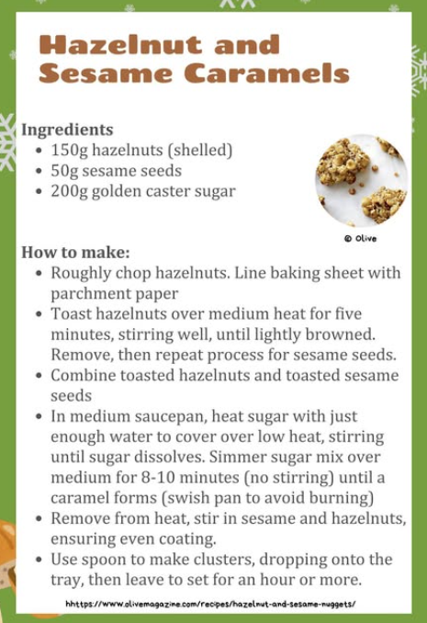
Social Media
The OHA has significantly increased their online presence.
We post Recipes…..

Slide 10
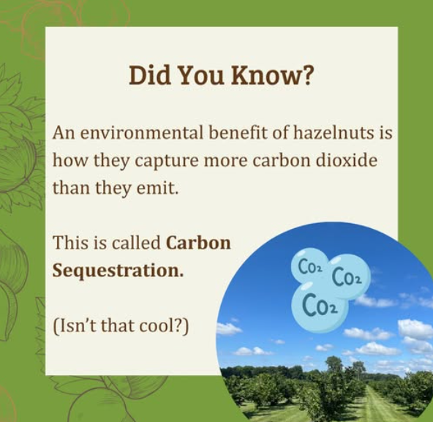
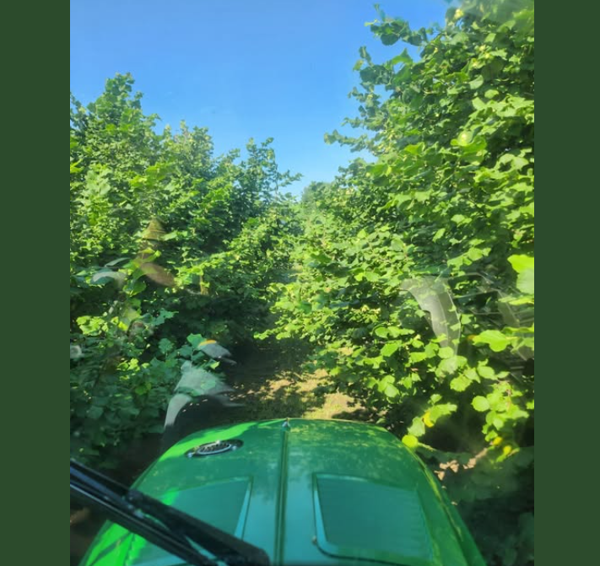
Fun Facts
Farm Photos

Slide 11


Highlighting Our Impact
Notifications of Events

Slide 12
Nearing the Finish Line
All OHA members will receive a copy of the final report after the project is complete at the end of June
The report will include:
A food traceability guide
Marketing toolkit for your farm
Key takeaways from the project

