Slide 1
Ontario Hazelnut
Association
Where Are We Today?

Slide 2


Meet the
Team
The Project
Building on foundational research on enhancing market access and value capture in Ontario's hazelnut industry, this next phase explores the formation of a hazelnut co-operative to strengthen the supply chain and create new market opportunities for Ontario growers.

Slide 3
OHA Survey Highlights
Farmer
Insights
(51% response rate)
82% of OHA members have less than 10 acres planted.
58% have allotted 0–4 acres for hazelnut production.
34% of farmers were planning to expand their orchards.
38% were not going to expand; 28% were still unsure.
Key concerns: pests, cost management, knowledge gaps, and limited processing infrastructure.

Slide 4
Previous
Findings
What Did the Research Tell Us?
Our research identified the need for a commercial aggregator to consolidate supply from Ontario's small-scale hazelnut farms and connect them to diverse market channels — including chocolatiers, bakery chains, breweries, independent grocers, and granola brands.
We aim to follow through — furthering the research that is essential to building a co-operative.

Slide 5
Anticipated
Findings
What can the Research Tell Us?
Grower segmentation & demographics
Geographic clustering & facility siting
Orchard maturity & production trajectory
Mechanization readiness
Service outsourcing
Demand
Sales channel diversification
Barriers to market access
Cooperative governance & buy-in factors

Slide 6
Our Methodology
Desk
Research
Empirical
Research
Critical
Examination
Literature review,
market analysis,
policy scanning
OHA member surveys,
stakeholder interviews,
farm visits
Thematic analysis,
supply chain mapping,
financial modeling

Slide 7
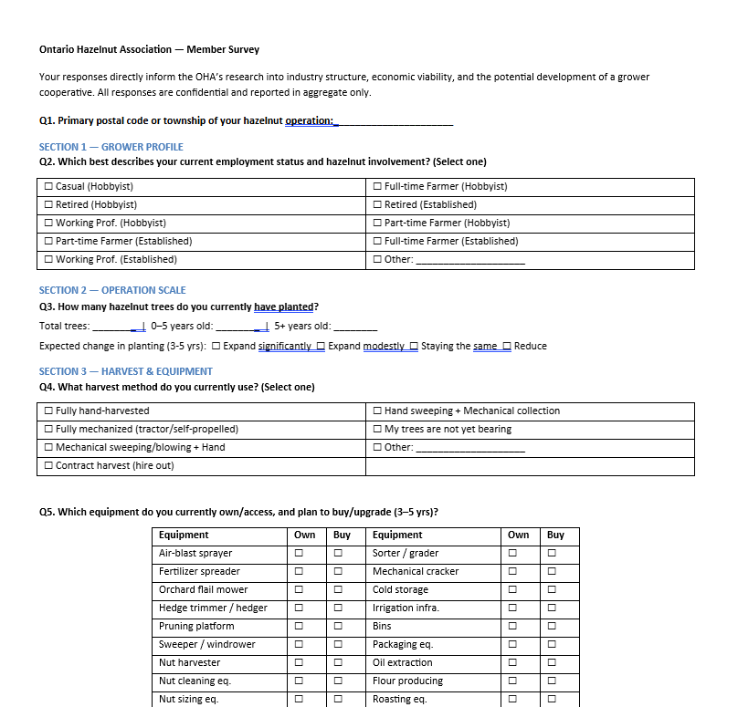
Our
Survey
Co-operative Feasibility Survey
We are conducting a comprehensive survey of OHA members to assess interest in, and viability of, forming a hazelnut co-operative in Ontario. The survey explores member needs, expectations, and willingness to participate in cooperative structures.

Slide 8
Our
Survey
Survey Goals
Grower Profile
Operation Scale
Harvest & Equipment
Sales
Marketing & Pricing
Cooperative Interest
Community & Engagement
Optional Follow-Up Contact

Slide 9
Our
Survey
Breakout Room Discussion
What potential
advantages can you
see emerging from a
hazelnut co-operative?
What services would
you want a co-op
to offer?

Slide 10
Thank You
Earl Hughson
Vice Chair, OHA
Steve Duff
Chief Economist, OMAFRA
Dr. Kalinga Jagoda
Professor, Department of Management
Ayush Chawla
PhD student, Department of Management

