Slide 1
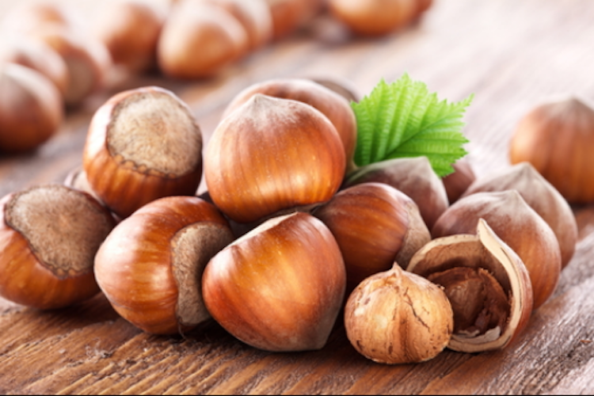

Ontario Research Update
2023 Hazelnut Symposium

Slide 2
Topics
- Regional hazelnut cultivar trials
- Breeding northern winter hardy hazelnuts (Dale)
- Irrigation trial
- Grower surveys

Slide 3
Ontario Regional Hazelnut Cultivar Trials
Melanie Filotas, Jenny Liu - OMAFRA
Katerina Jordan, Afisa Munawar, Cathy Bakker - University of Guelph
Sharon Regan, Queens University
Giacomo Bianchi, Ferrero
John Zandstra, Greg Watt, Sydney Boersma, University of Guelph

Slide 4
Cultivars
Oregon | Rutgers
1. Yamhill | 7. Beast
Jefferson | 8. Raritan
Theta | 9. Monmouth
York | 10. Hunterdon
2. McDonald | 11. Somerset
3. Wepster
4. Dorris
5. Felix
Eta
Sacajawea
6. Polly O
Epsilon
Zeta

Slide 5
Cultivars
Grimo | Hodgson
12. Marion | 15. 5C
13. North Blaze | Norfolk
14. Dermis | Chelsea
Michigan (Cecil Farris)
16. Grand Traverse

Slide 6
Honorable Mention
Nature Tech Nursery
  Courtenay, BC
North American Plants
  McMinnville, OR
Foggy Bottom Tree Farm
  Columbus, NJ

Slide 7
 | EFB (Rutgers) | Kernel Wt. (g) | % Kernel Weight | S-alleles
Yamhill | + | 1.12 | 49 | 8, 26
Dorris (P) | + | 1.50 | 43 | 1,12
Wepster | + | 1.11 | 47 | 1, 2
McDonald | + | 1.21 | 51 | 2, 15
Felix (P) | + | 1.32 | 50 | 5, 21
PollyO | ? | 1.38 | 48 | 2, 10
Beast (P) | - | 0.9 | 44 | 8, 23
Raritan | - | 1.14 | 48 | 3, 22
Monmouth | - | 1.19 | 52 | 1,12
Hunterdon | - | 1.23 | 46 | 1, 3
Somerset | - | 1.14 | 55 | 3, 10
Marion | - | 1.2 | 37 | 14, 25
N. Blais | - | 1.0 | 35 | 8, 25
Dermis | - | 1.0 | 38 | 12, 16
5C | - | - | - | ?
Grand Traverse (P?) | + | 1.3 | 50 | 11, 25

Slide 8
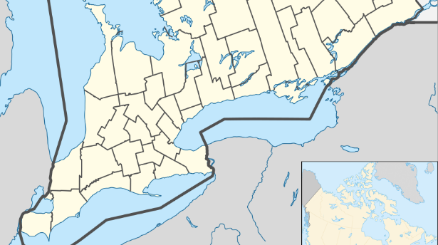
Locations
Huron Research Station
Uxbridge area
Niagara
Kingston area
Cedar Springs Research Station
Simcoe Research Station

Slide 9
Cedar Springs Research Station
Plant Hardiness Zone 6b
55 % sand
31 % silt
14 % clay
Sandy Loam
4.6 % OM
pH = 6.9
Planted June 7, 8, 2022.

Slide 10
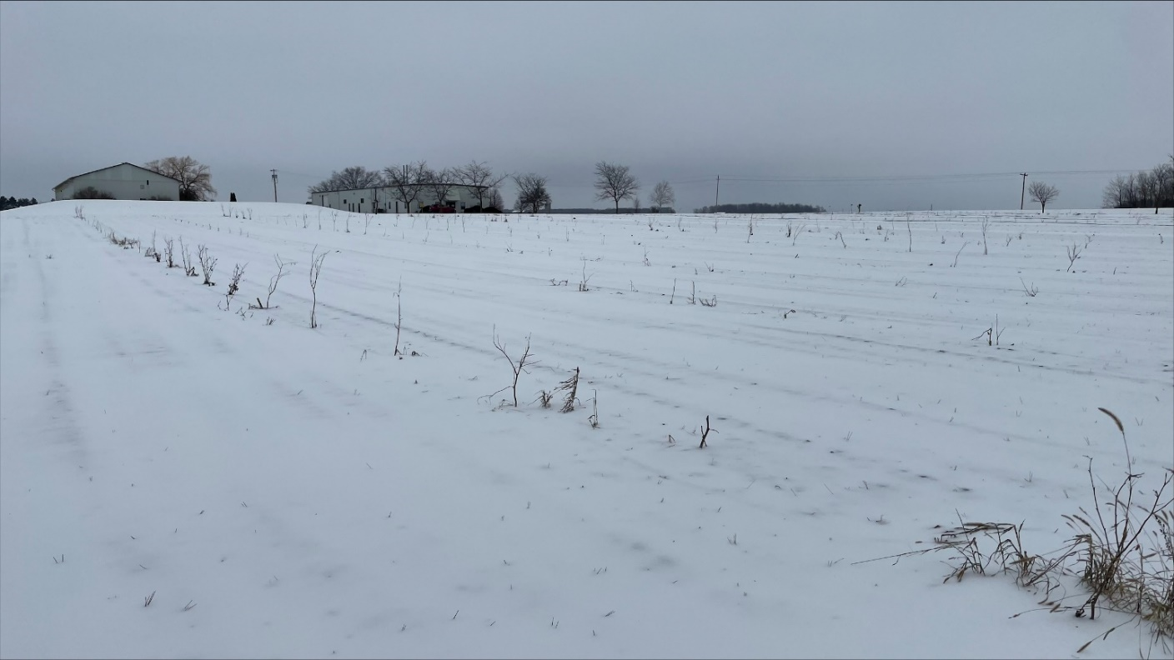
Huron Research Station
Plant Hardiness Zone 6a/6b
3.8 % Organic Matter
pH = 7.3
26 % sand
34 % silt
40 % clay
Clay Loam
Planted 17 June, 2022
only 3 replicates

Slide 11
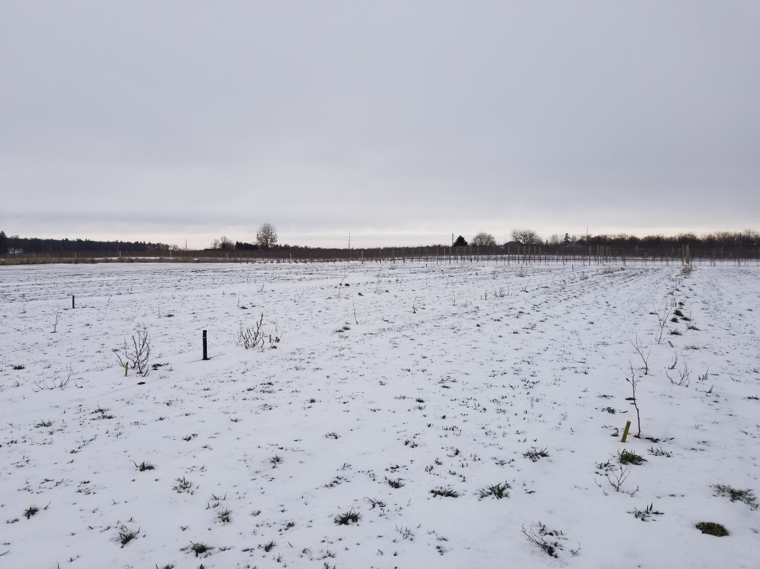
Simcoe Research Station
Plant Hardiness Zone 6a/6b
74 % sand
18 % silt
8 % clay
Sandy Loam
1.9 % OM
pH = 6.0
Planted August 29, 30 2022.

Slide 12
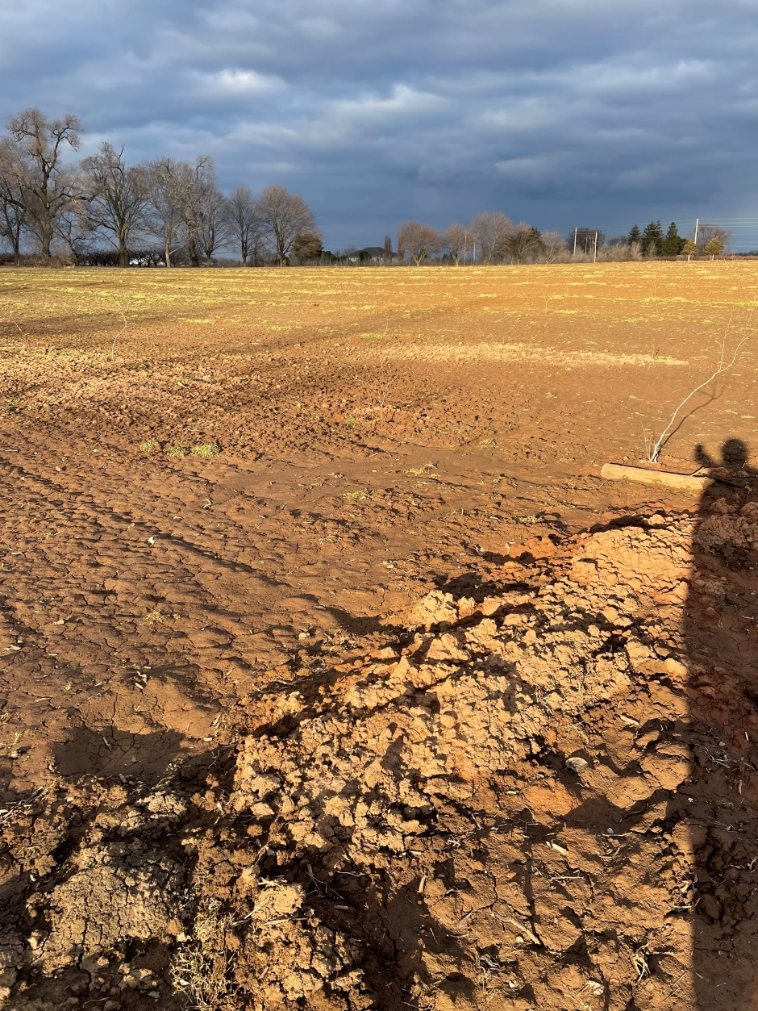
Vineland Research and Innovation Center
Plant Hardiness Zone 7a
60 % sand
26 % silt
14 % clay
Sandy Loam
3.2 % Organic Matter
pH = 5.4
applied 2 t/ha dolomitic lime
Planted September 27, 28 2022.

Slide 13
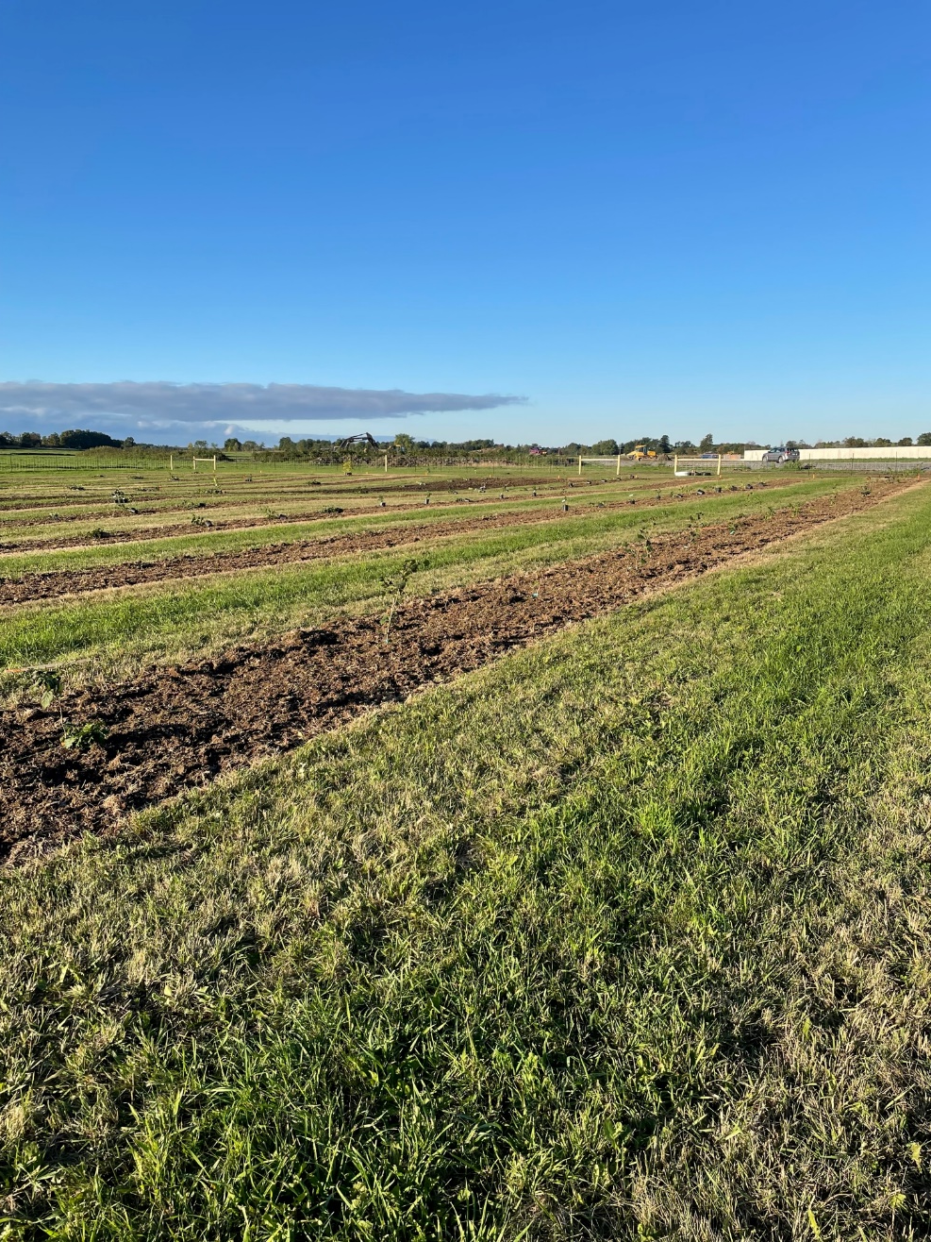
Joyceville
Plant Hardiness Zone 5b/6a
38 % sand
33 % silt
29 % clay
Clay Loam
5.1 % OM
pH = 6.3
Planted on 29, 30
September 2022

Slide 14
Trial Design/Data Collection
- 5 trees per plot by 4 replicates (3 in Huron)
  - 20 trees of each cultivar per location
- 3.0 m between trees; 6.0 m row width
irrigated
multiple trunks
- Data collection after planting:
- shoot number
- length of longest shoot
- trunk diameter of longest shoot

Slide 15
Others cultivars of interest
New releases by Dr Tom Molnar (Rutgers)
  1 to 2 years out
“Campina”
  Brought hazelnut seedlings from Europe
  No nuts - no pollinators; interplanted “native” hazelnuts
  Not sure if clonal or seedlings from nuts
  Never found EFB although in an area of heavy pressure
  Heavy nut crop and large number of catkins

Slide 16
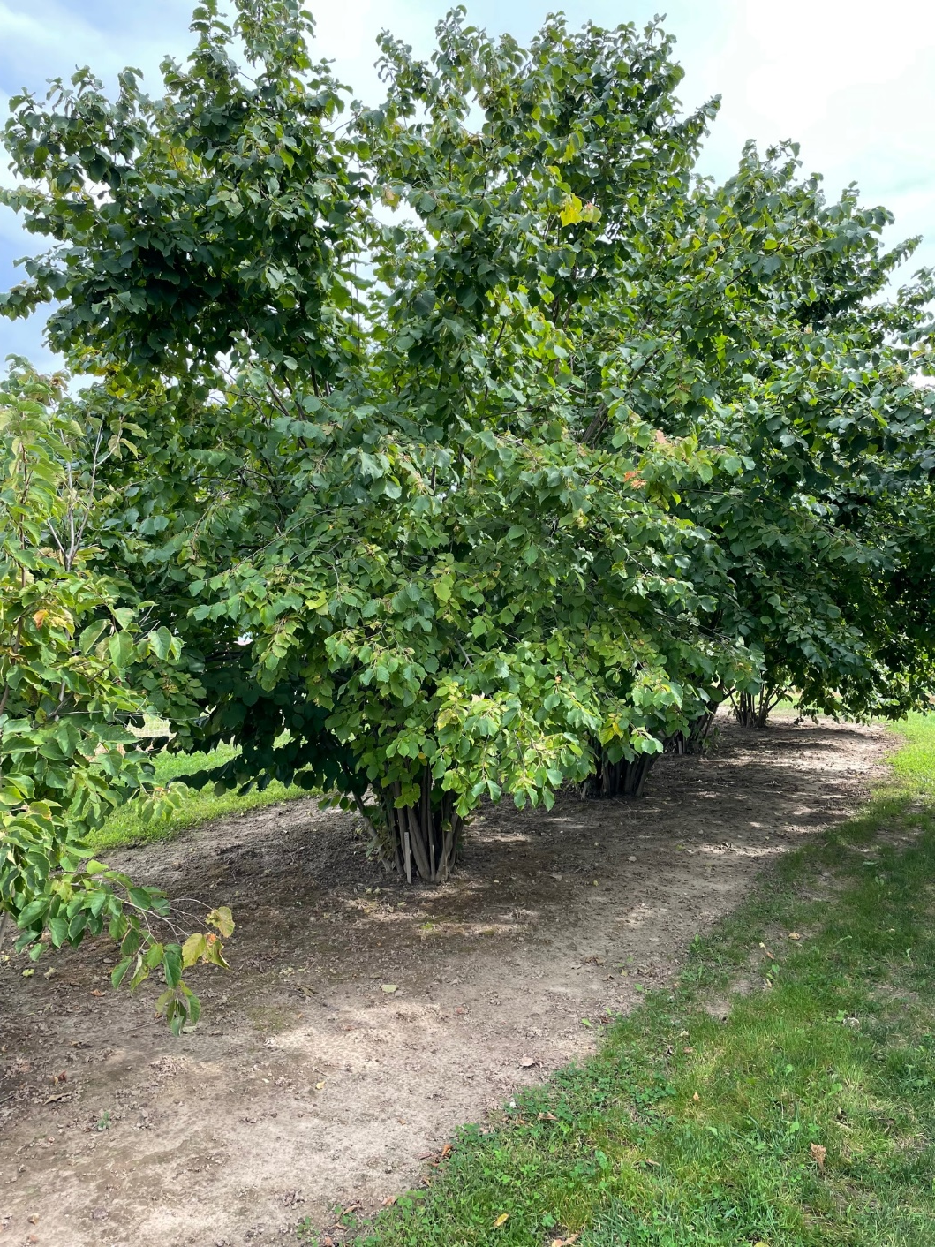
Others cultivars of interest
Campina

Slide 17
North Bay Planting – Dale and Molnar
Family | Planted | % Alive
14526 | 77 | 62.3%
14501 | 89 | 57.3%
14505 | 14 | 57.1%
14525 | 76 | 39.5%
14510 | 96 | 35.4%
14511 | 52 | 34.6%
14524 | 56 | 33.9%
14523 | 63 | 30.2%
14504 | 111 | 29.7%
14507 | 25 | 28.0%
14522 | 18 | 27.8%
14521 | 55 | 20.0%
14502 | 26 | 19.2%
Norfolk | 7 | 14.3%
Chelsea | 7 | 14.3%
Total | 772 | 37.6%
Survival (%)
2016 | 94
2017 | 99
2018 | 90
2019 | 93
2020 | 73
2021 | 65
2022 | 38

Slide 18
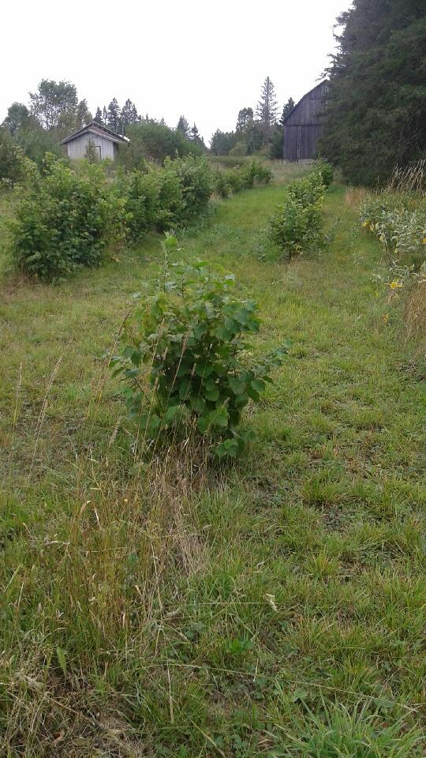
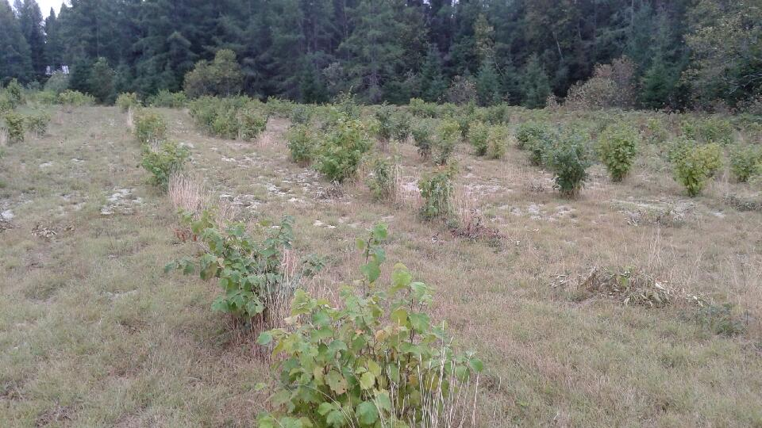
North Bay Planting – Rutgers

Slide 19
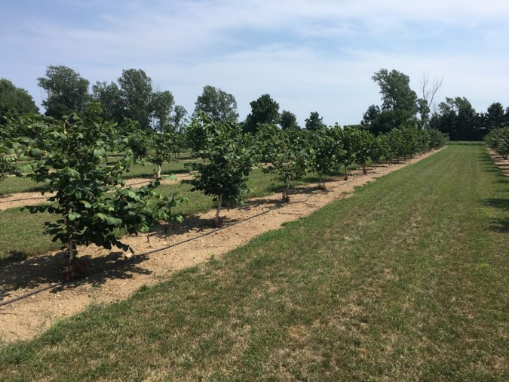
Hazelnut Irrigation
- Ontario Agrifood Innovation Alliance project that was completed in 2020
  - Still ongoing
Irrigation treatments are:
  No irrigation
  50% field capacity
  75 % field capacity
  100% field capacity
- Cultivars: Gene, Yamhill and Carmela

Slide 20
Hazelnut yield and nut numbers in response to irrigation levels

Slide 21
Hazelnut nut weight in response to irrigation

Slide 22
Grower Surveys
- Focused on survival and health ratings
- Chose larger plantings: > 30 trees
- Long time between planting and evaluation
- Range of locations (Hardiness Zone, soil types)
- Grower management practices are not considered

Slide 23
Tree Health Ratings
1 = no tree
2 = dead
3 = only suckers
4 = poor health
5 = less than healthy
6 = healthy
0 = missing tree
1 = dead
2 = only suckers
3 = < 50% healthy leaves
4 = > 50% but < 100% healthy leaves
5 = all of tree is healthy

Slide 24
Grower 1
Plant Hardiness Zone 7a; silty clay soil
2021 Rating of 2016 Planting (5 years)
Cultivar | Mortality (%) | Health Rating
Tonda di Giffoni | 13.0 | 4.6
Santium | 7.3 | 4.8
Gamma | 6.0 | 4.7
Theta | 4.3 | 4.8
Jefferson | 3.7 | 4.7
Delta | 3.5 | 4.5
Yamhill | 1.5 | 4.8
Lewis | 0 | 4.9

Slide 25
Grower 2
Plant Hardiness Zone 6a
2019 Rating of 2016 Planting (3 years)
Cultivar | Mortality (%) | Health Rating
Jefferson | 19 | 4.2
Gamma | 20 | 4.5
Yamhill | 14 | 4.8
Gene | 4 | 4.9

Slide 26
Grower 3
Plant Hardiness Zone 6b; clay soil
2021 Rating of 2016 Planting (5 years)
Cultivar | Mortality (%) | Health Rating
Jefferson | 50 | 3.8
Yamhill | 23 | 4.8
Gene (2017) | 0 | 4.1

Slide 27
Grower 4
Plant Hardiness Zone 6a/6b; sandy soil
4 year Ratings
Cultivar | Mortality (%) | Health Rating
Jefferson (2015) | 27 | 3.2
Yamhill (2015) | 3 | 4.5
Jefferson (2016) | 41 | 3.4
Yamhill (2016) | 8 | 3.9

Slide 28
Grower 5
Plant Hardiness Zone 5b;
2019 Rating of 2016, 2017 Planting (4, 3 years)
Cultivar | Mortality (%) | Health Rating*
Jefferson (2016) | 21 | 5.3
Alex (2016) | 22 | 5.4
Gene (2016) | 20 | 5.6
Carmela (2016) | 7 | 5.1
Jefferson (2017) | 90 | 3.7
Alex (2017) | 49 | 6.0
Matt (2017) | 18 | 5.5
Linda (2017) | 20 | 5.9
Carmela (2017) | 7 | 4.8
Marion (2017) | 3 | 6.0
Andrew (2017) | 1 | 6.0

Slide 29
Conclusions
- Range of survival of the same cultivar across the same field, same grower
- Range of survival of the same cultivar in different years, same grower
- Appear to be able to grow in clay soils
Relative mortality, for whatever reason, similar for some cultivars across sites: Jefferson > Yamhill
but not for others: Jefferson > Gamma
or Jefferson = Gamma

Slide 30

Acknowlegement
This project is funded by the Ontario Ministry of Agriculture, Food and Rural Affairs (OMAFRA), through the Ontario Agri-Food Innovation Alliance

Slide 31
Thank-you

